Slide 1
Wave-U-Net for Background Noise Suppression
Signal Processing for AI in Audio
Reichman University 2024

Slide 2
Team Members
Omri Newman
Adar Cohen
Yuval Sheinin
omrinewman@gmail.com
adar123cohen@gmail.com
Yuvalsh1233@gmail.com

Slide 3
Project
Overview
Link to Drive
Successfully enhance the clarity of speech by reducing background noise in audio signals i.e. increase SNR
Generate clean and noisy speech samples using the MS-SNSD framework
Utilize the Wave-U-Net-PyTorch model designed for audio source separation
Transfer learn and fine-tune this model for noise suppression
Report results and conduct experiments

Slide 4
Generating Data (MS-SNSD)
“The Microsoft Scalable Noisy Speech Dataset is a noisy speech dataset that can scale to arbitrary sizes depending on the number of speakers, noise types, and Speech to Noise Ratio levels desired.”
Can specify SNR levels, background noise types, total length, and more
Comes pre-segmented into training and testing sets
Implemented a shuffling technique to merge then randomly divide data into new train and test sets to ensure an even distribution of data
Modified data to exhibit 5-stems like MUSDB18 data for compatibility
with the Wave-U-Net model
Generated data with 20 dB SNR for training and testing
2.5 hours train data, 40 minutes test data
Generated data with 0 dB, 5 dB, and 10 dB for experiments
Generated data with specific background noises for experiments

Slide 5
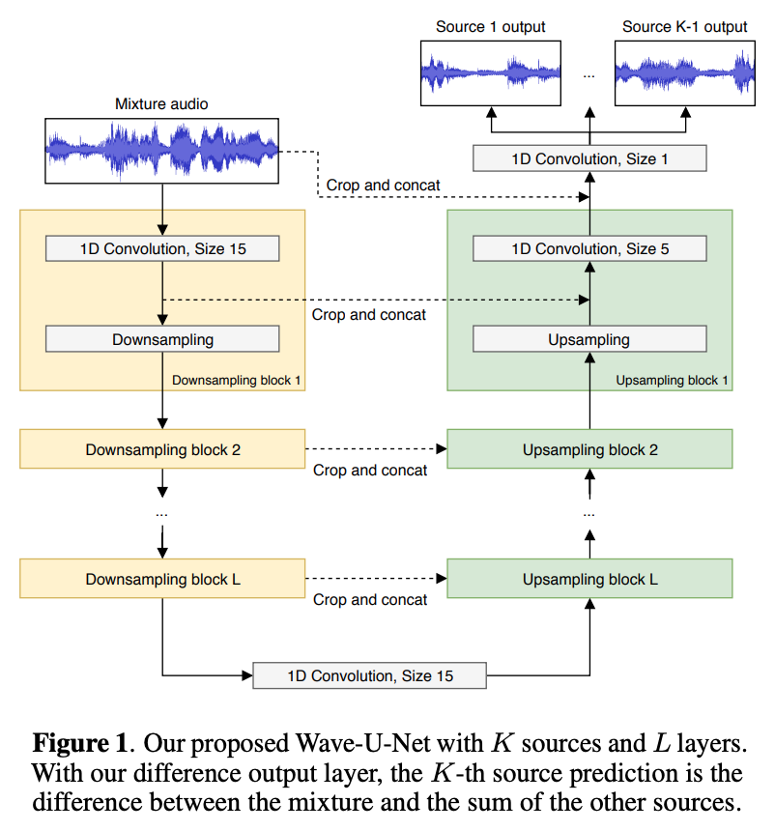
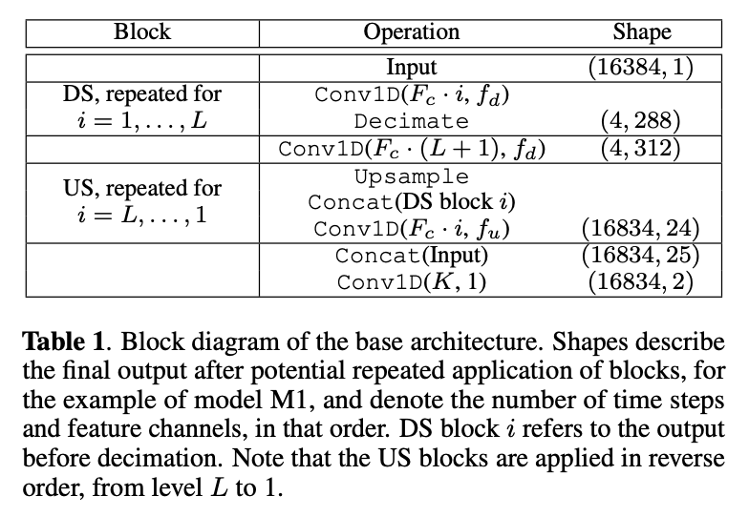
Wave-U-Net Model
The Wave-U-Net-PyTorch model is a convolutional neural network architecture designed for end-to-end audio source separation. The model processes audio through downsampling and upsampling blocks. During downsampling the model uses 1D convolutions to extract features from the input audio. Then the model upsamples the features back to the original resolution, concatenating with features from the corresponding downsample block. The final step involves a convolution to output the separated audio sources
Notes:
fine-tuning all weights vs just upsampling

Slide 6
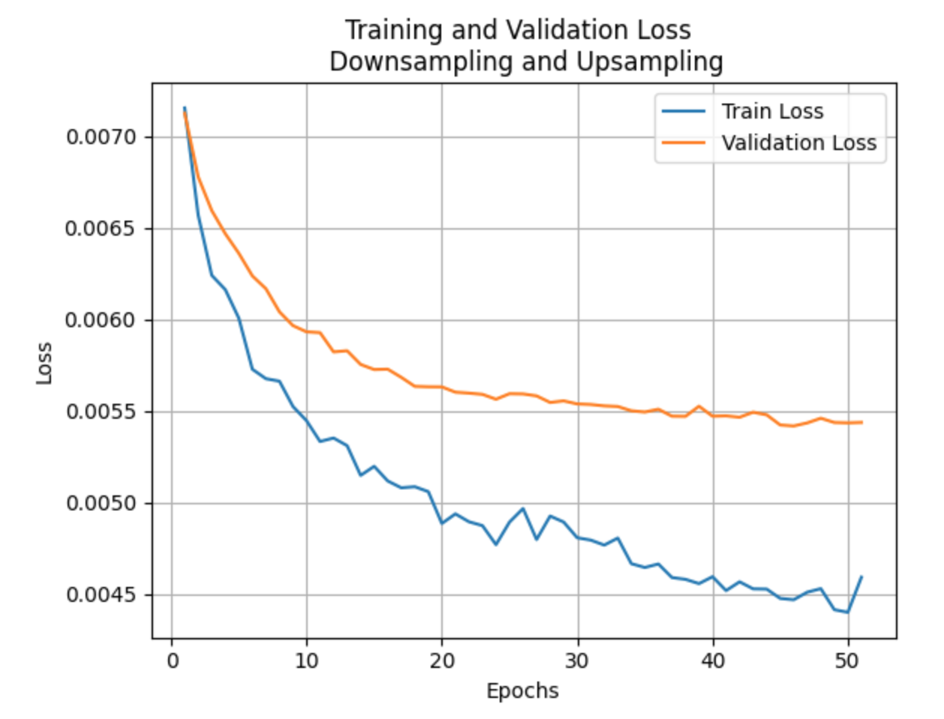
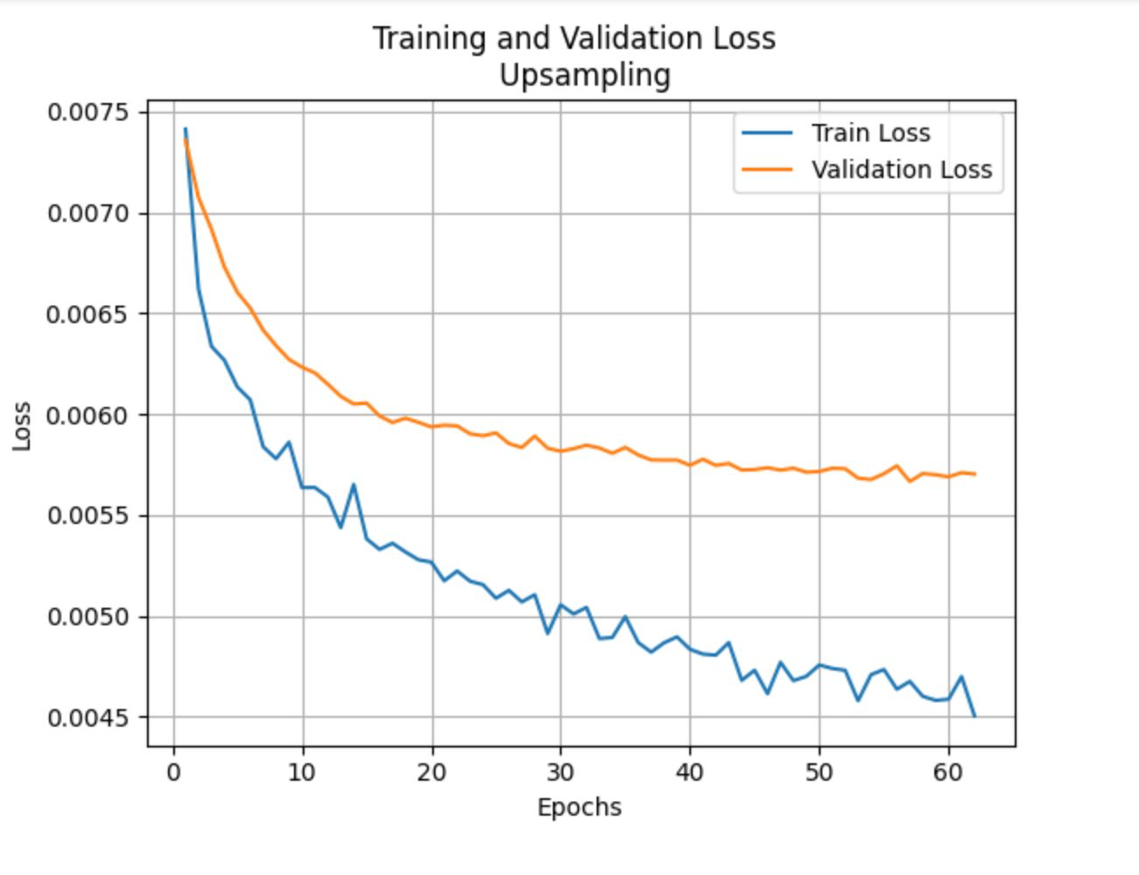
Training and Validation MSE Loss
Training loss decreases consistently
Validation loss decreases then stabilizes
Generalizes well to unseen data
No overfitting

Slide 7
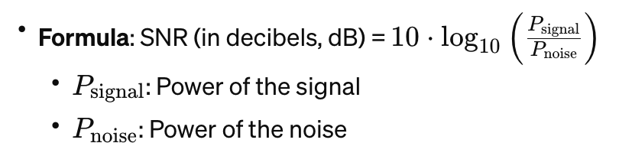
Signal-to-Noise Ratio (SNR)
SNR measures the clarity of a signal in comparison to the background noise. It is a ratio of signal power to the noise power, expressed in decibels (dB).
In our use case, higher SNR means the source signal (e.g. voice) is more distinguishable from the noise, indicating a clearer and cleaner separation.

Slide 8
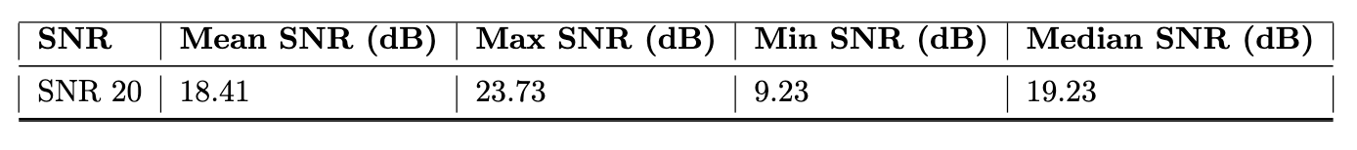

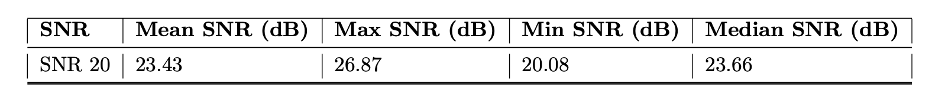
Results
Pre-Trained Wave-U-Net
Fine-Tuned Wave-U-Net
*Upsampling and Downsampling
Notes:
Tested on 40 minutes of test data

Slide 9
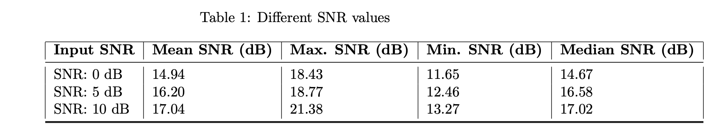
Robustness Check
Performed SNR robustness check using the 20dB fine-tuned model on test data generated with lower SNR levels
Each groups test size is roughly five minutes
Across the board increase in SNR values, indicating the model is robust to varying levels of background noise.

Slide 10
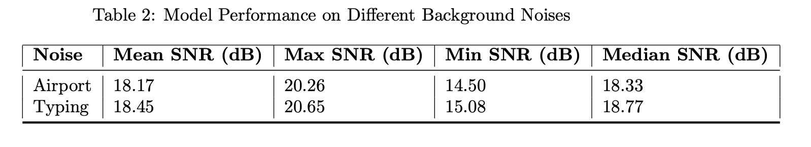
Testing Background Noises
Generated 20 dB SNR data with specific background noises for testing purposes
Each groups test size is roughly five minutes
Used Airport Announcements as one group and Typing as another
Expected non-vocal background noises to perform better than vocal ones
Overall performance for both groups was rather poor

Slide 11
Challenges & Problems Solved
Failed attempt with proposed model (Deezer’s Spleeter), finding an appropriate substitute
Learn how to work with and configure Microsoft data
Coordinate between Microsoft data and expected input of Wave-U-Net model
Reconcile between 5-stem inputs and 2-stem inputs
Configure Wave-U-Net model to fine-tune only some weights versus all
Understand the proposed metric and implement SNR function
Work collaboratively with computationally heavy model and large data
GPU and RAM

Slide 12
Conclusion
Successfully demonstrate the effectiveness of the Wave-U-Net-PyTorch model for noise reduction in speech processing — Robust to varying SNR levels
Results may vary depending on type of background noise present — More to explore
Generalizing to other datasets
Highlights the potential of deep learning-based approaches for addressing real world signal processing challenges

Slide 13
References
Stoller, D., Ewert, S. and Dixon, S., 2018. Wave-u-net: A multi-scale neural network for end-to-end audio source separation. arXiv preprint arXiv:1806.03185.
Radfar, M. H., Dansereau, R. M., & Wong, W. (2019). Speech Separation Using Gain-Adapted Factorial Hidden Markov Models. ArXiv. /abs/1901.07604
Mamun, N., Khorram, S., & Hansen, J. H. (2019). Convolutional Neural Network-based Speech Enhancement for Cochlear Implant Recipients. ArXiv. /abs/1907.02526
Phan, H., McLoughlin, I. V., Pham, L., Chén, O. Y., Koch, P., De Vos, M., & Mertins, A. (2020). Improving GANs for Speech Enhancement. ArXiv. https://doi.org/10.1109/LSP.2020.3025020
Wang, K., He, B., & Zhu, W. (2021). TSTNN: Two-stage Transformer based Neural Network for Speech Enhancement in the Time Domain. ArXiv. /abs/2103.09963
Chandan KA Reddy et al., “A scalable noisy speech dataset and online subjective test framework,” arXiv preprint arXiv:1909.08050, 2019.
Andreas Jansson, Eric J. Humphrey, Nicola Montecchio, Rachel Bittner, Aparna Kumar, and Tillman Weyde. Singing voice separation with deep U-Net convolutional networks. In Proceedings of the International Society for Music Information Retrieval Conference (ISMIR), pages 323–332, 2017.

Slide 14
THANK YOU!

